Slide 1


Slide 2
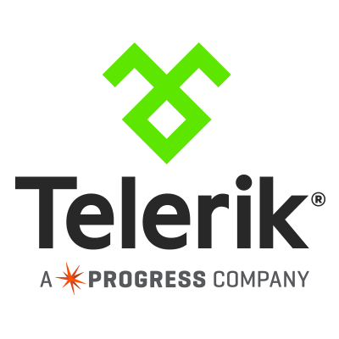
Ed Charbeneau
Developer Advocate, Telerik
Author: TDN & Simple-Talk
Podcast: Eat Sleep Code the Official Telerik Podcast
Twitter: @EdCharbeneau

Slide 3
I hope you enjoy the presentation.
Notes:
History
Have fun
Netflix - homework

Slide 4
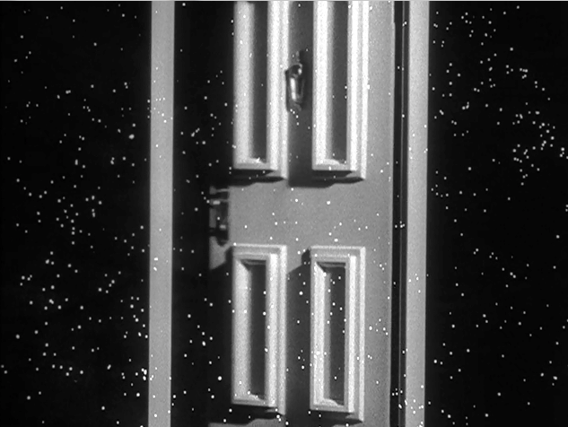
You're traveling through another dimension

Slide 5
a dimension not only of sight and sound but of data;

Slide 6
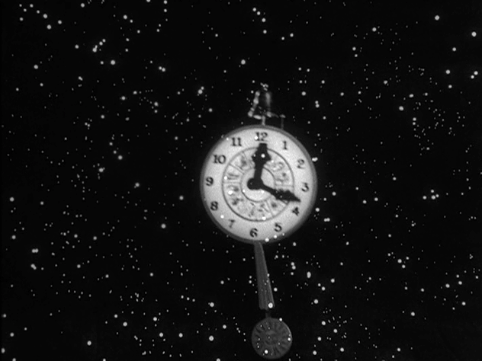
a journey into a wondrous land whose boundaries are that of the imagination.

Slide 7
Next stop…

Slide 8
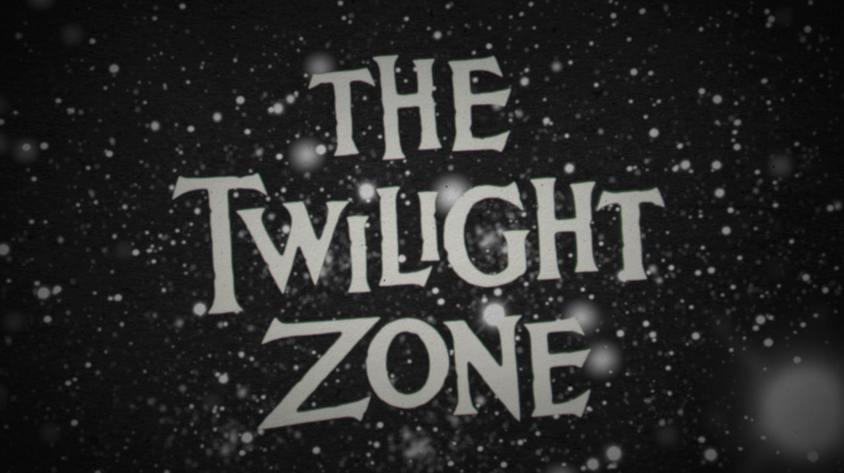

Slide 9
Why??
Notes:
Why the twilight zone?

Slide 10
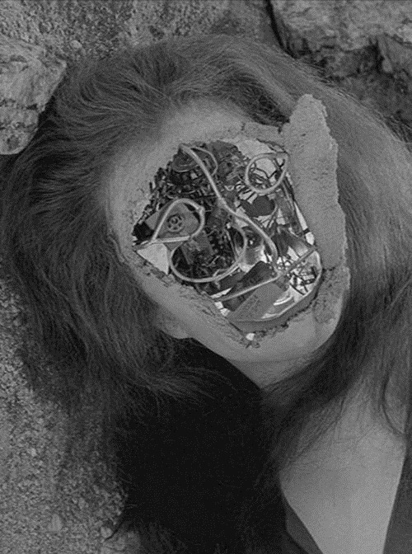
Twilight Zone dealt with many topics… Frequently the topic of technology.

Slide 11
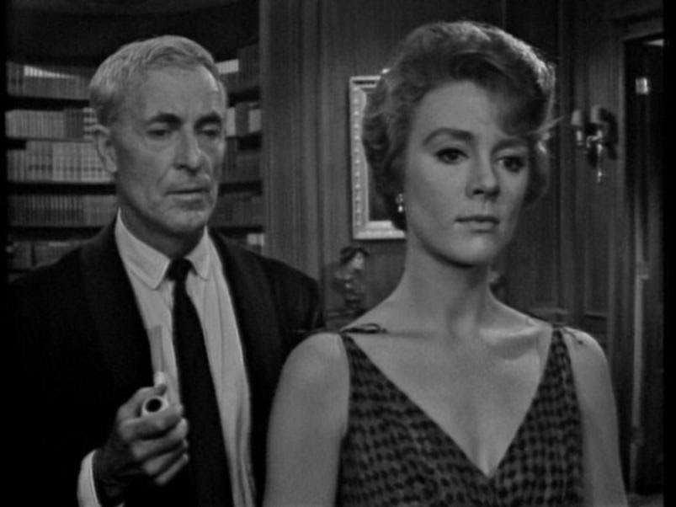
However the common theme throughout the show wasn’t the technology itself

Slide 12
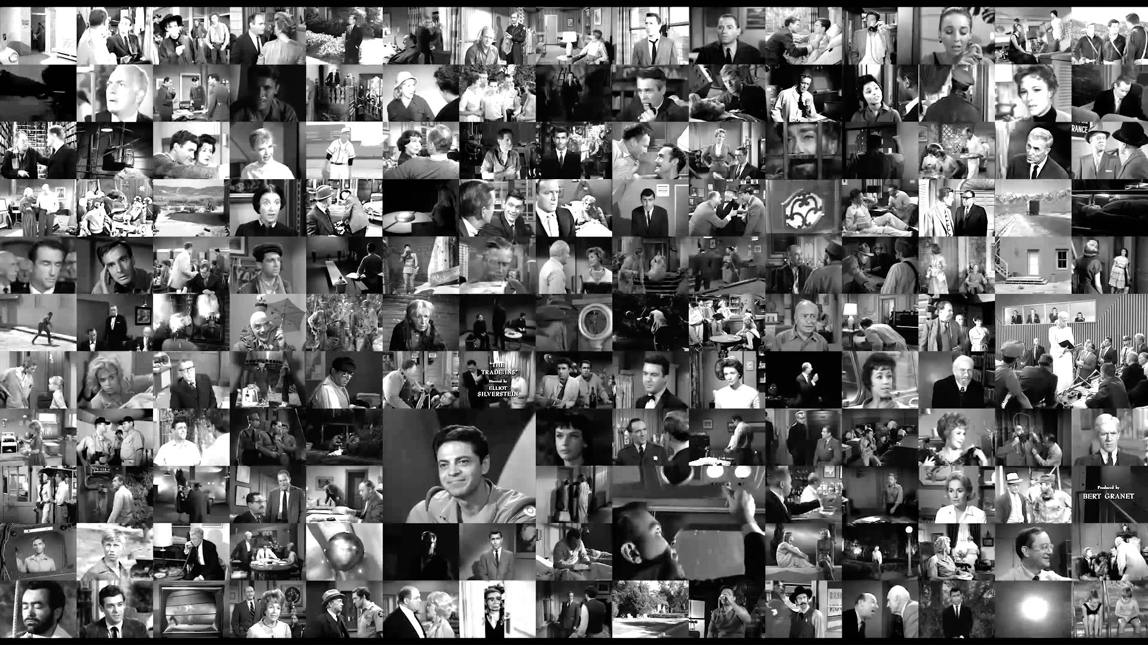
The theme was the human condition

Slide 13
3 Technologies Each will shape our future
?
?
?

Slide 14
How will we react?

Slide 15
Using references from the past, will give us a perspective of time, which we can use to estimate the future.
Notes:
Twilight Zone aired in mid-century
The atomic age
Back when the future looked futuristic
Fins on everything and wild SciFi ideas

Slide 16
Let’s begin with Big Data
Big Data
?
?

Slide 17
Big Data
Extremely large data sets that may be analyzed computationally to reveal patterns, trends, and associations, especially relating to human behavior and interactions.

Slide 18
Data and Data Technologies
1961

Slide 19
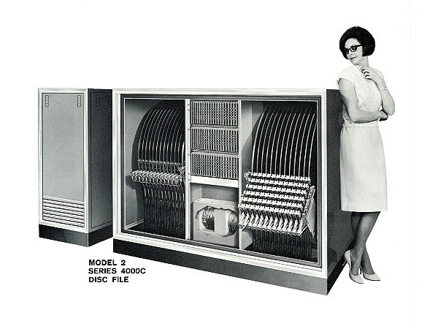
Data Storage in 1961
Hard Disk Drive
52 inches tall
70 inches wide
39 inch disks
Total Capacity 205MB
Had to be bolted to a concrete floor
Roughly 3.6 Million Dollars per GB

Slide 20
Data and Data Technologies
1961
Today

Slide 21
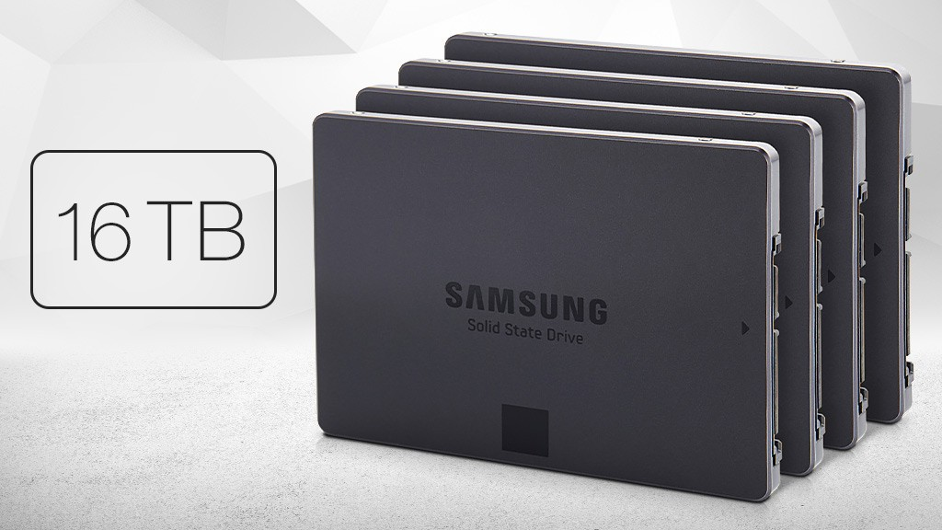
Data Storage in Today
16 Terabytes
2.5 inches
Price per GB has dropped to nearly 3 cents per GB

Slide 22
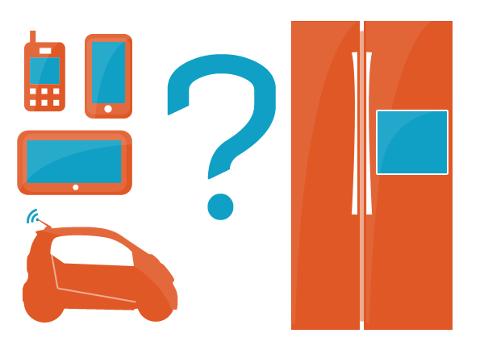
More space = more data
More than 90% of all the data in the globe was generated over the course of past two years.
The total volume of data that the industry captures and stores, gets doubled in every 1.2 years.
Notes:
The more space we create, the more space we fill.
This is a human condition, if we see an empty space, we have the need to fill it.
The result is an exponential growth in data.

Slide 23
Data and Data Technologies
1961
Today
2020

Slide 24
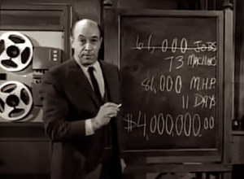
More space = more data
the amount of digital information that exists in the present time will grow from 3.2 zettabytes to 40 zettabytes, by 2020
Equivalent to 125 million years worth of Twilight Zone episodes.
Notes:
We’re creating massive amounts of data and uploading it to YouTube, FaceBook, Twitter, the web.
We’re uploading things like Video, Wearable sensor data, IoT data, phone data, an infinite list of things that is constantly growing.

Slide 25
Why??
Notes:
Why do we need data? What can we use it for?

Slide 26
Data and Data Technologies
1854
1961
Notes:
Let’s go back in time before computers and see an important event where data changed the world.

Slide 27
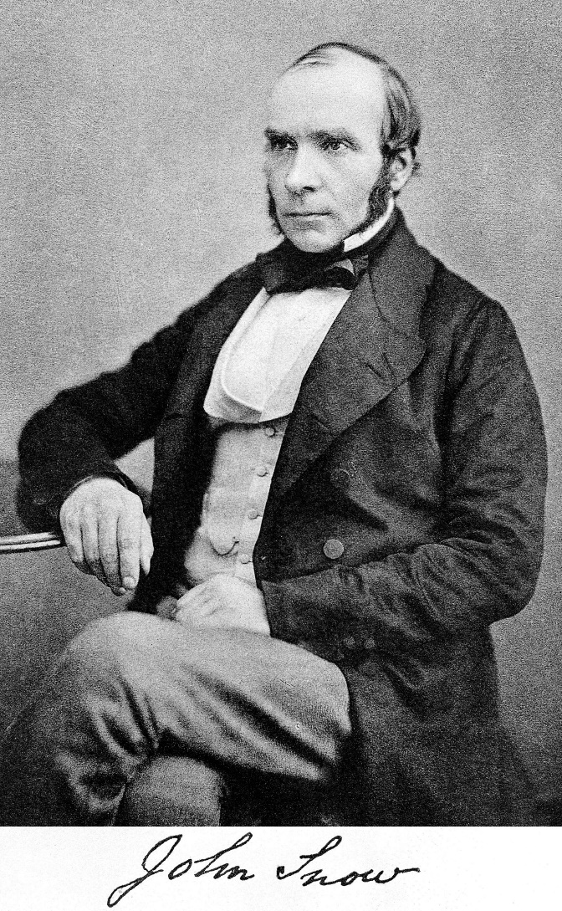
1854 Broad Street cholera outbreak
Regarded as the founding event of the science of epidemiology (the study of the patterns, causes, and effects of health and disease conditions in defined populations)
Notes:
This is John Snow, physician
He would use data to change the way we look at health, disease and the patterns that caused outbreaks.

Slide 28
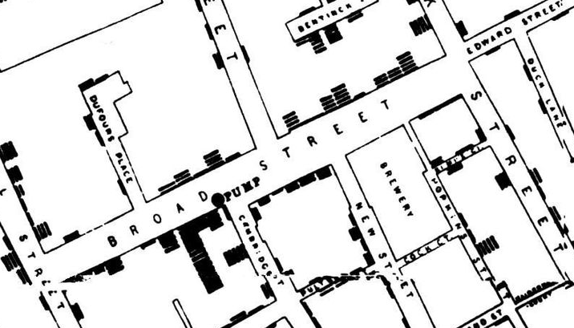
1854 Broad Street cholera outbreak
Dominant theory stated that Cholera spread by “Bad air”
John Snow used statistics to illustrate the connection between the quality of the water source and cholera cases
Notes:
The dominant theory at the time was that foul smelling air spread disease, and death caused by Cholera.
John took a simple map walked the city door to door collecting data. For each death from Cholera, he added a dot to his map.
Eventually his data showed a trend.
The highest collection of dots, seemed to gravitate around a water pump. While a nearby brewery had no cases of the outbreak.
Because the people at the brewery drank beer for breakfast, lunch, and dinner. They weren’t exposed to the cholera in the water.
Keep in mind, this was a time before germ theory. People didn’t understand how illness spread, because we didn’t fully understand what was even making us sick.
Even without knowing about the germ that was making people sick, he was able to determine the source of the outbreak and question the “Bad Air” theorists.
This would eventually result in clean drinking water and a immediate drop in infant mortality by 50%
Later they would determine that the water supply may have been contaminated by a dirty diaper which was washed into a nearby cesspool that was too close to the watersupply.

Slide 29
Data and Data Technologies
Today
Future

Slide 30
Predicting Future Outbreaks
Harvard researchers analyzed anonymous phone call records of 15 million users.
Mobile phone data may be used to capture seasonal human movement patterns that are relevant for understanding childhood infectious diseases.
Researchers plan to test if the same method is as effective in forecasting malaria and cholera outbreaks and eventually be used by doctors and other medical professionals.
Notes:
http://www.engadget.com/2015/08/30/princeton-harvard-rubella-kenya-phone-study/?ncid=rss_semi
Today, we’re trying to predict outbreaks using other data.
Harvard researches created a study where they used anonymous phone call records of 15 million users to understand human movement patterns.
Researchers plan to use this model for forecasting outbreaks like malaria, rubella, cholera and eventually this will be accessible to the medical community.

Slide 31
Predicting Future Outbreaks
Big Data could be used to predict outbreaks using a much broader forms of data:
Wearables
GPS Data (phones)
Thermostat Data (Nest)
Vehicle Data
Medical Data
Increased accuracy
Increased foresight
Notes:
In the future our predictive capabilities could be better.
Using other forms of data could give us even more insight into health patterns.

Slide 32
Human Condition
When is it socially acceptable to use our data and what types of data will we allow access to?

Slide 33
Moving forward
How will we make sense of zettabytes of data ?

Slide 34
Bringing us to Machine Learning
Big Data
Machine Learning & AI
?

Slide 35
Artificial Intelligence
Computer systems able to perform tasks that normally require human intelligence, such as visual perception, speech recognition, decision-making, and translation between languages.

Slide 36
AI Technologies
1950s

Slide 37
1950s “AI” Research Begins
1950 Alan Turing proposes the Turing Test as a measure of machine intelligence.
1956 Dartmouth Conference, considered the birth of AI
1958 Lisp language invented
Results in big concepts
Reasoning as Search
Natural Language
Micro-worlds

Slide 38
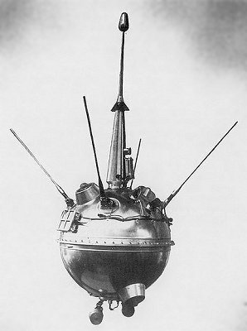
Big Ideas in Science
1958 the first commercial nuclear power plant in the United States
1959 Soviets land [unmanned] on the moon
Notes:
Remember we have big ideas going on at this time. We are very ambitious.
Major life changing events are taking place like nuclear power and space flight.
We were doing things that were once science fiction.

Slide 39
Problems & Limitations
For decades, the capabilities of AI programs were limited. Even the most impressive could only handle trivial versions of the problems they were supposed to solve.
Limited Resources
Computing Power
Limited Storage & Memory
Notes:
Our ideas surpassed our capabilities to execute.

Slide 40
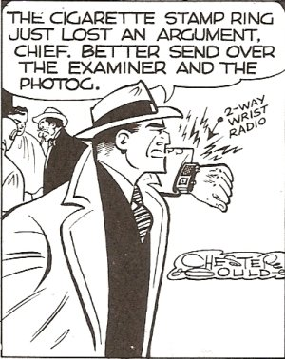
Big Ideas in Science Fiction
Sometimes big ideas need time for science to catch up before they can be made a reality.
Notes:
Just like nuclear power and space travel, sometimes big ideas need time to catch up.

Slide 41
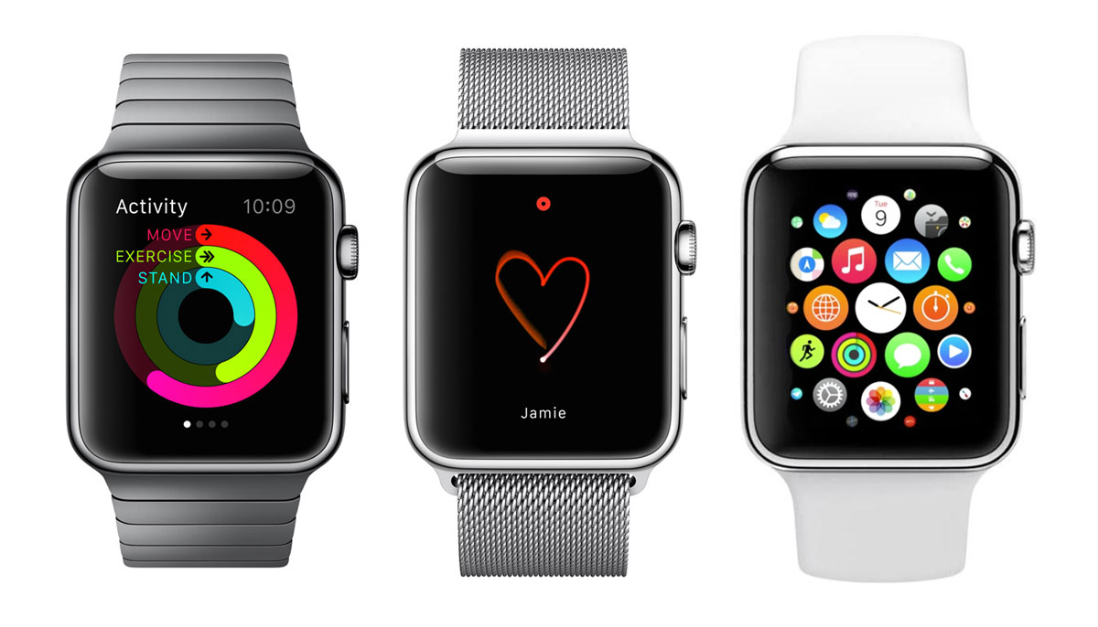
Big Ideas in Science Fiction
Sometimes big ideas need time for science to catch up before they can be made a reality.
Notes:
But eventually, since fiction becomes reality.

Slide 42
AI Technologies
1950s
Today

Slide 43
Machine Learning
Machine learning is a subfield of computer science that evolved from the study of pattern recognition and computational learning theory in artificial intelligence. Machine learning explores the study and construction of algorithms that can learn from and make predictions on data.

Slide 44
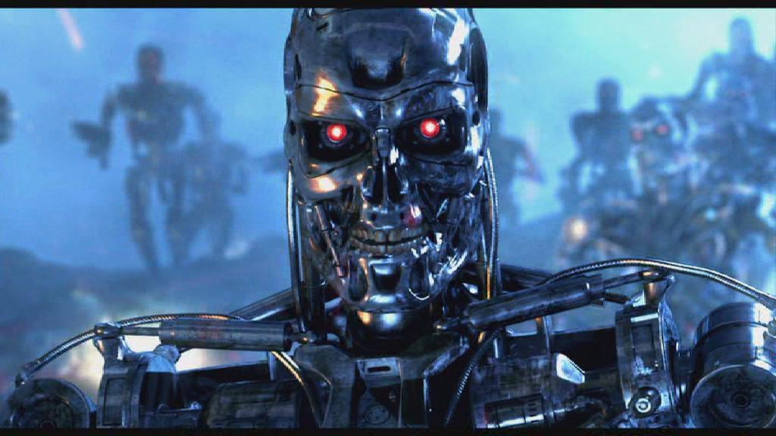
Artificial General Intelligence
A hypothetical machine that could successfully perform any intellectual task that a human being can
Notes:
Science fiction has given us ideas about AI.
But were not talking about that kind of AI.

Slide 45
Artificial General Intelligence
Fear of AGI today shouldn’t be our focus. We’re talking about Machine Learning.
However, the human condition still applies.
Notes:
The fear of AGI should be our focus.
Our focus is on just a fraction of the AI universe, Machine Learning.
We should dismiss all of our worries though, the human condition still applies. Machine Learning can get creepy really fast. Just not Terminator creepy.

Slide 46
Machine Learning in Use
Who
Why
Google
Microsoft
Apple
Facebook
Amazon
Sitefinity Digital Experience Cloud
Government
And many, many more
Making personalized recommendations for customers
Natural Language
Siri, Cortana, Google Now
Forecasting long-term customer loyalty
Anticipating the future performance of employees
Rating the credit risk of loan applicants
Notes:
Everything we touch from the “software giants” google, Microsoft, apple use machine learning in some way.
Things as trivial as the windows phone keyboard.
Cortana, Siri, Google Now
Microsoft Delve

Slide 47
Predictions based on Data
Big Data
Machine Learning & AI
Machine Learning & AI
Today

Slide 48
Machine Learning for the Masses
Azure Machine Learning
Amazon Machine Learning
TensorFlow (Google)

Slide 49

Creepy Uses for ML
Target Figured Out A Teen Girl Was Pregnant Before Her Father Did
Unintended consequences, human condition.

Slide 50
With Great Power…
A computer scientist has pioneered an artificial intelligence-driven method of modeling the behaviors of militant groups, and the Department of Defense is interested.

Slide 51
AI Technologies
1950s
Today
Future

Slide 52
Much More Data
Data Sources
Scope of Data
Wearables
IoT
GPS Data (phones)
Thermostat Data (Nest)
Vehicle Data
Medical Data
3d-video capture (Kinect)
Search history
Twitter history
Collected from birth
In every aspect of our lives
About all of our habits, likes, dislikes, moods
Data we have no use for today, can be useful tomorrow

Slide 53
Moving forward
What happens when we make sense of our data?

Slide 54
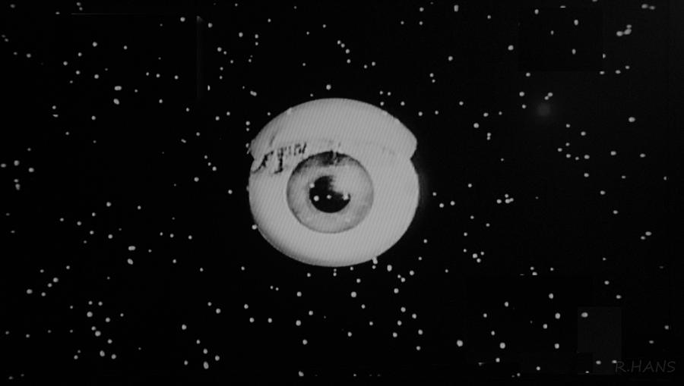
Anonymous Data
Anonymous Data can be reverse engineered manually. Sounds like an application for Machine Learning.

Slide 55
The Decision
Does the benefit outweigh our need for privacy?

Slide 56
Augmented Reality
Big Data
Machine Learning & AI
Augmented Reality

Slide 57
Augmented Reality
A live direct or indirect view of a physical, real-world environment whose elements are augmented (or supplemented) by computer-generated sensory input

Slide 58
AI Technologies
1958

Slide 59
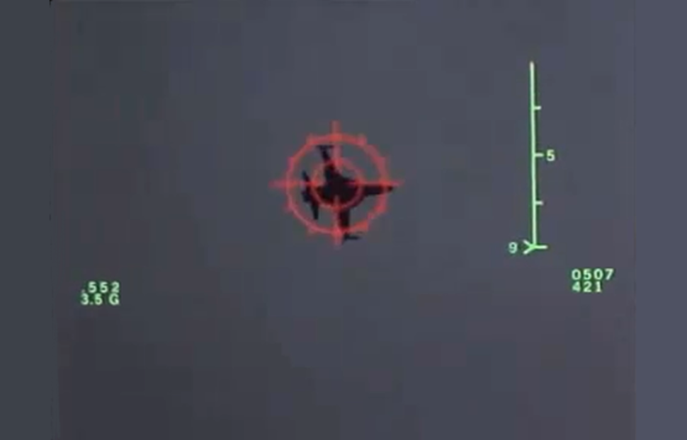
Heads Up
1958 the world's first Head Up Display in operational service

Slide 60
AI Technologies
1958
Yesterday

Slide 61
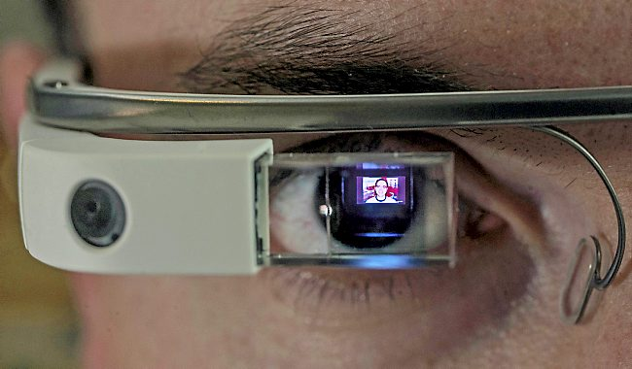
HUD Powered AR
Google Glass
Success or Failure?
Human conditions
Privacy
Data collection
Socially Akward

Slide 62
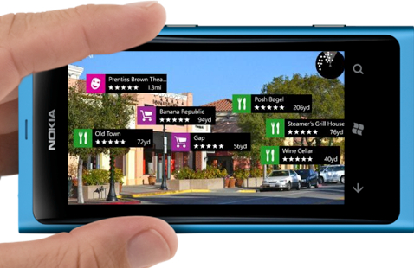
Mobile Powered AR
Camera provides a live image
Sensors and data are used to overlay information

Slide 63
Mobile Powered AR
This would be complete science fiction just a short time ago

Slide 64
AR Amplified
Big Data
Machine Learning & AI
Machine Learning & AI
Augmented Reality
Today

Slide 65
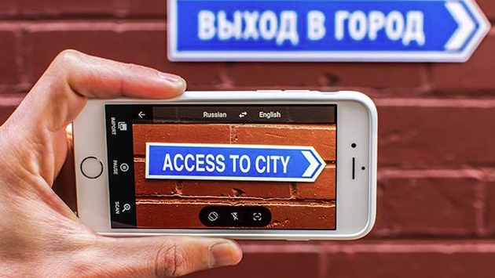
Enhanced Mobile Powered AR
Translate signage in real time.

Slide 66
AI Technologies
1958
Today
Near Future

Slide 67
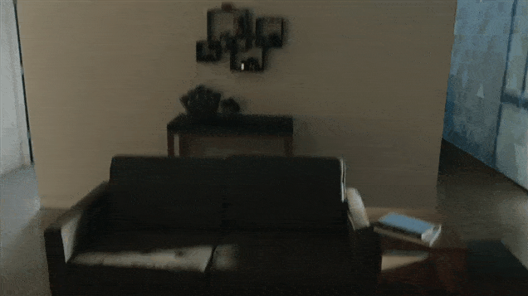
Heads Up, Again
Microsoft HoloLens
Advances the abilities of AR by detecting physical space. Augments walls, floors, and other objects.

Slide 68
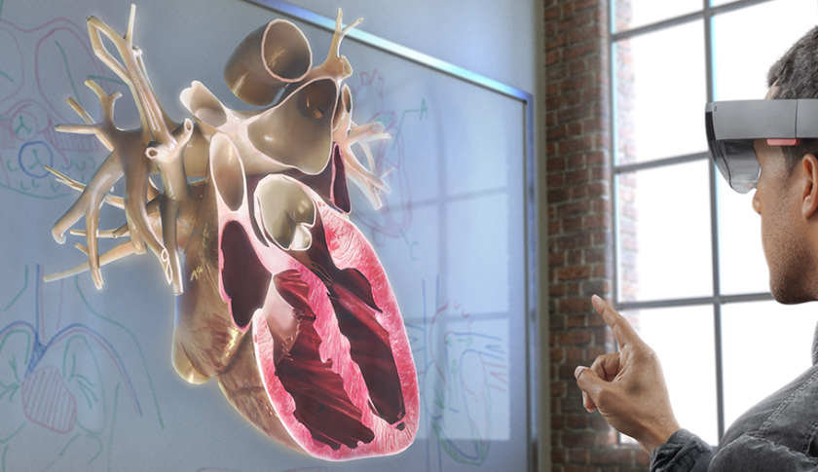
Possible Applications
Medicine

Slide 69
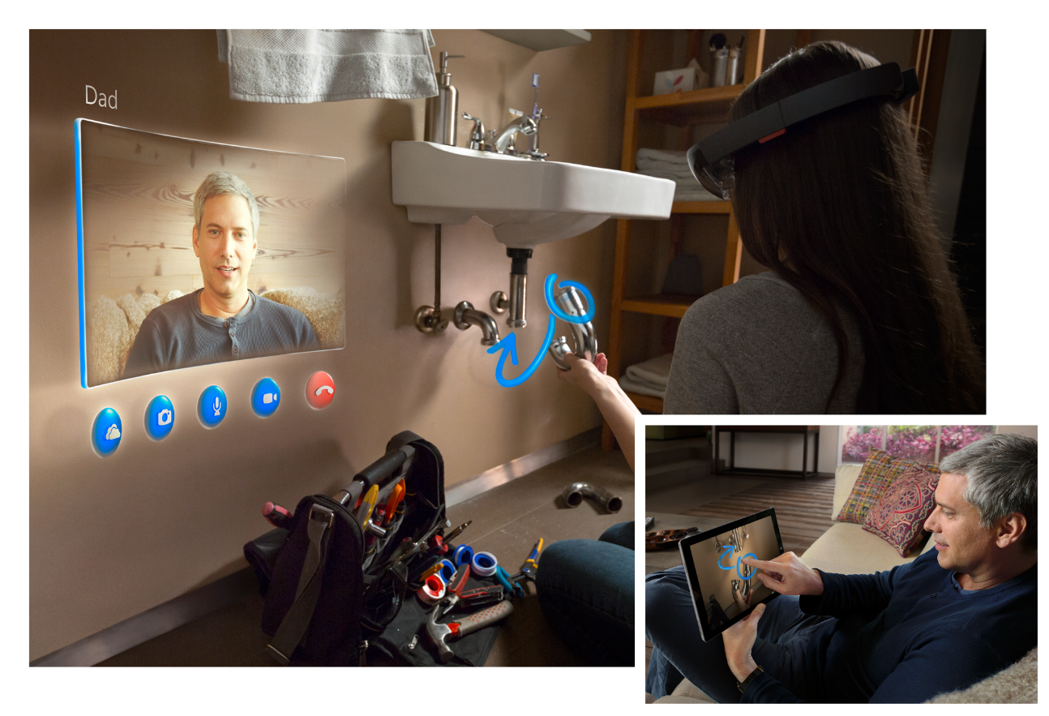
Possible Applications
Industrial, Education

Slide 70
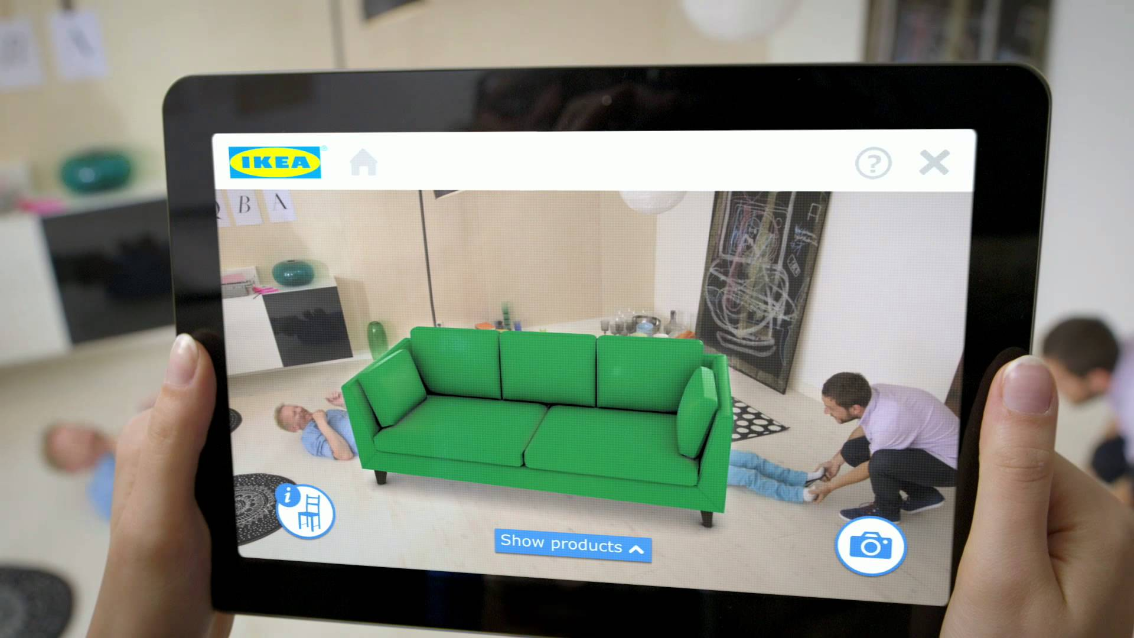
Possible Applications
Virtual Showrooms

Slide 71
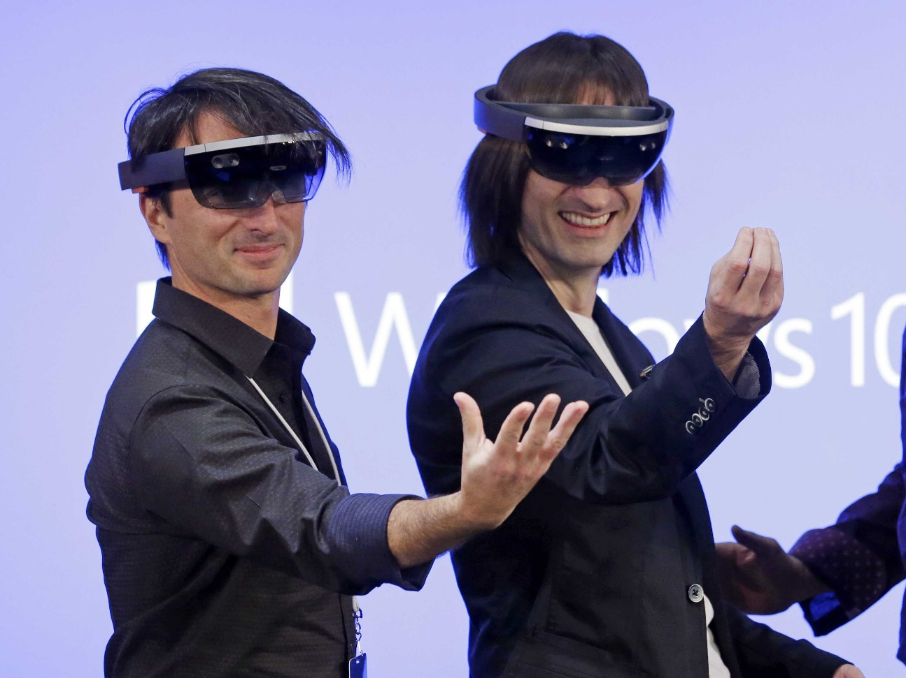
Human Condition
Looking Silly

Slide 72
AI Technologies
1958
Today
Near Future
Future

Slide 73
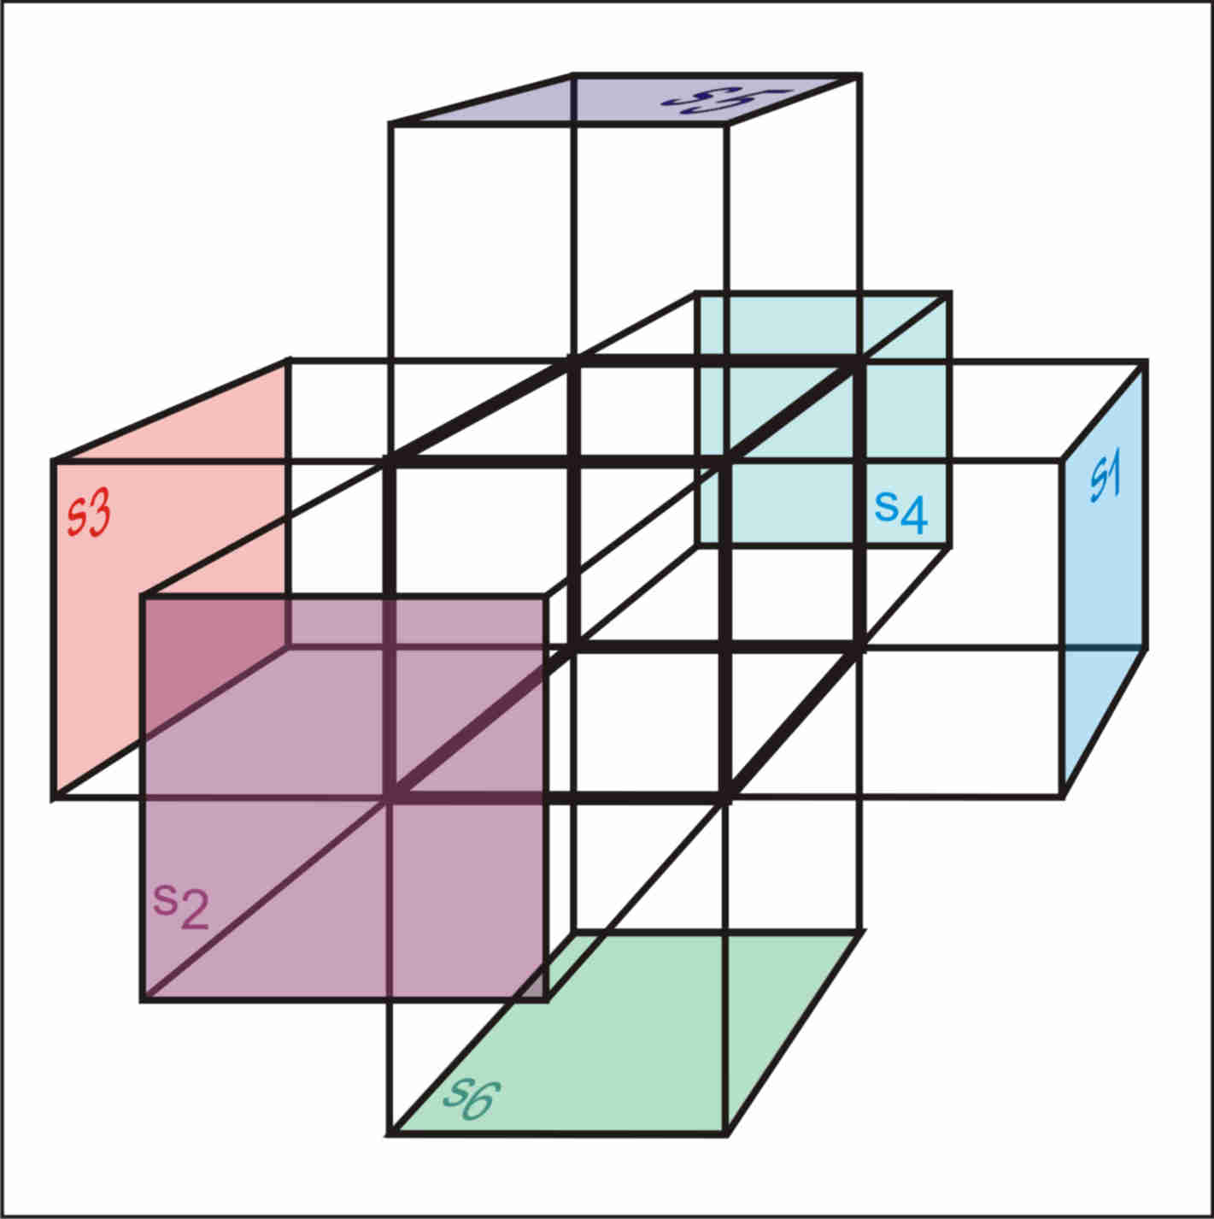
The Next Dimension
Using data as a virtual 4th dimension, many environments represented by data could occupy the same augmented real world space.

Slide 74
Information Overload
Difficulty separating virtual life with reality?

Slide 75
Distant Future
Big Data
Machine Learning & AI
Machine Learning & AI
Augmented Reality

Slide 76
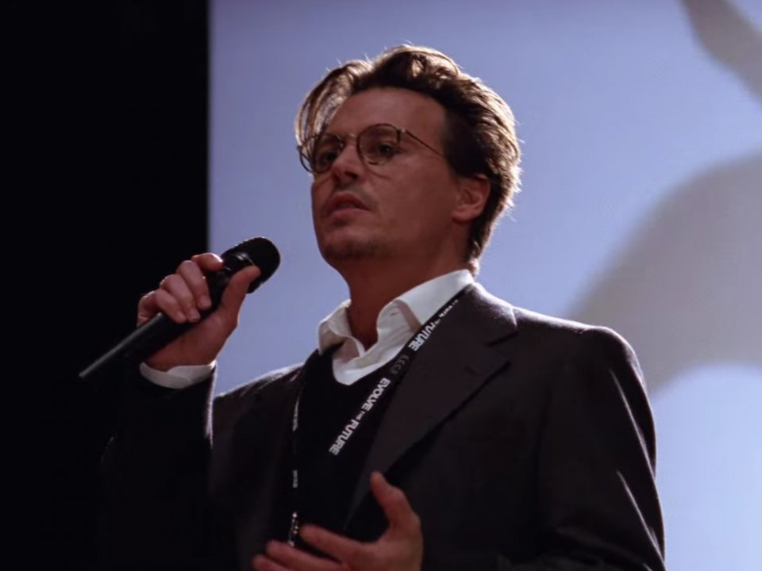
Mind Uploading Redefined
Personal “Big Data” collected over a lifetime could be equivalent to uploading one’s mind.

Slide 77
Virtual Consciousness
What are the implications of the virtual consciousness?

Slide 79
Distant Future (alternate ending)
Big Data
Machine Learning & AI
Machine Learning & AI
Augmented Reality

Slide 80
The Choice Is Ours
Using technology we’ll predict and cure disease, create new areas of science, and solve real problems.

Slide 81
The End
?
?
?

Slide 82
Research
What Every Manager Should Know About Machine Learning
Google is open-sourcing its new machine learning system behind Google Photos
The biggest myths and misconceptions about artificial inteligence, from the experts
John Snow (physician) - Wikipedia, the free encyclopedia
Google researcher: We'll be "highly dependent’ on AI in the future
Introducing U-SQL – A Language that makes Big Data Processing Easy - The Visual Studio Blog - Site Home - MSDN Blogs
How It Works | Frameri Eyewear
Phone data can predict infectious disease outbreaks
IBM's 'Rodent Brain' Chip Could Make Our Phones Hyper-Smart | WIRED
What is Microsoft doing with machine learning?
Eric Horvitz on the new era of Artificial Intelligence | Microsoft Research Luminaries | Channel 9
Disney's $1 Billion Bet on a Magical Wristband | WIRED
Videos | Barclay T. Blair
Infographic: Trillion-Fold Rise in Computing Puts a 1985 Supercomputer on Our Wrists - Singularity HUBSingularity HUB
Apple Acquires Augmented Reality Company Metaio | TechCrunch
Augmented Reality in the Browser with Awe.js
Top Augmented Reality Apps of Summer 2014 | Marxent
Everyday AI – it’s not just about robots | ITProPortal.com
Artificial intelligence: Should we be as terrified as Elon Musk and Bill Gates? | ZDNet
Top 10 Amazing Facts To Know About Big Data
Stephen Hawking, Elon Musk, and Bill Gates Warn About Artificial Intelligence | | Observer
Big data & AI vs ISIS
Antivirus Might Catch More Malicious Code Using Neural Networks | MIT Technology Review
Home — TensorFlow
History of hard disk drives - Wikipedia, the free encyclopedia
Timeline of Computer History: 1959 | Computer History Museum
Timeline of Computer History: 1958 | Computer History Museum
A Very Short History Of Big Data - Forbes
Page Not Found
Timeline: 50 Years of Hard Drives | PCWorld
Top 10 Amazing Facts To Know About Big Data
5 Most Prophetic Twilight Zone Episodes | Smells Like Infinite Sadness
The incredible shrinking data center | Network World
There’s No Such Thing as Anonymous Data
courses.cs.washington.edu/courses/csep590/06au/projects/history-ai.pdf
Illumin - Deep Blue: The History and Engineering behind Computer Chess
Deep Blue (chess computer) - Wikipedia, the free encyclopedia
The Three Breakthroughs That Have Finally Unleashed AI on the World | WIRED
Predictive Analytics | When Machine Learning meets Real Life
Machine Learning for Programmers: Leap from developer to machine learning practitioner - Machine Learning Mastery
https://www.stat.auckland.ac.nz/~ihaka/downloads/Interface98.pdf
Breakthroughs in Artificial Intelligence from 2014 | MIT Technology Review
Artificial general intelligence - Wikipedia, the free encyclopedia
The AI Resurgence: Why Now? - Innovation Insights
Nuclear power in the United States - Wikipedia, the free encyclopedia
machine learning used to predict and model isis - Business Insider
How Target Figured Out A Teen Girl Was Pregnant Before Her Father Did - Forbes
4 no-bull takeaways about Google's machine learning project | InfoWorld
History of artificial intelligence - Wikipedia, the free encyclopedia
Timeline of artificial intelligence - Wikipedia, the free encyclopedia
Dartmouth Conferences - Wikipedia, the free encyclopedia
Data Science in the Cloud with Microsoft Azure Machine Learning and R - O'Reilly Media Free, Live Events
Augmented Reality: Past, Present and Future - TNW Industry

Slide 83
Credits
The Twilight ZoneTM
The Twilight Zone Is a registered trademark of CBS Corporation. This presentation “Into the next dimension” is in no way affiliated with or endorsed by CBS and are used here under the terms of Fair Use as defined in United States Copyright Doctrine.
Nor is it associated with Warner Bros., Viacom, New Line Cinema, United Paramount, The Scifi Channel, Cayuga Productions, Inc., the Serling Estate, or any of their affiliates which maintain trademarks on The Twilight Zone properties in part or in whole.

Slide 84
More credits
This presentation “Into the next dimension” is not affiliated with Megan Ellison or Annapurna Pictures. All trademarks and copyrights belong to their respective owners, and are used here under the terms of Fair Use as defined in United States Copyright Doctrine. Terminator is a registered trademark of StudioCanal Image S.A.
This presentation “Into the next dimension” is not affiliated with Transcendence, Warner Brothers Pictures or Summit Entertainment. All trademarks and copyrights belong to their respective owners, and are used here under the terms of Fair Use as defined in United States Copyright Doctrine.

